Slide 1



ChemCorp Analysis
View in Power BI
Last data refresh:
5/16/2020 11:16:14 AM India Standard Time
Downloaded at:
5/16/2020 11:19:17 AM India Standard Time

Slide 2
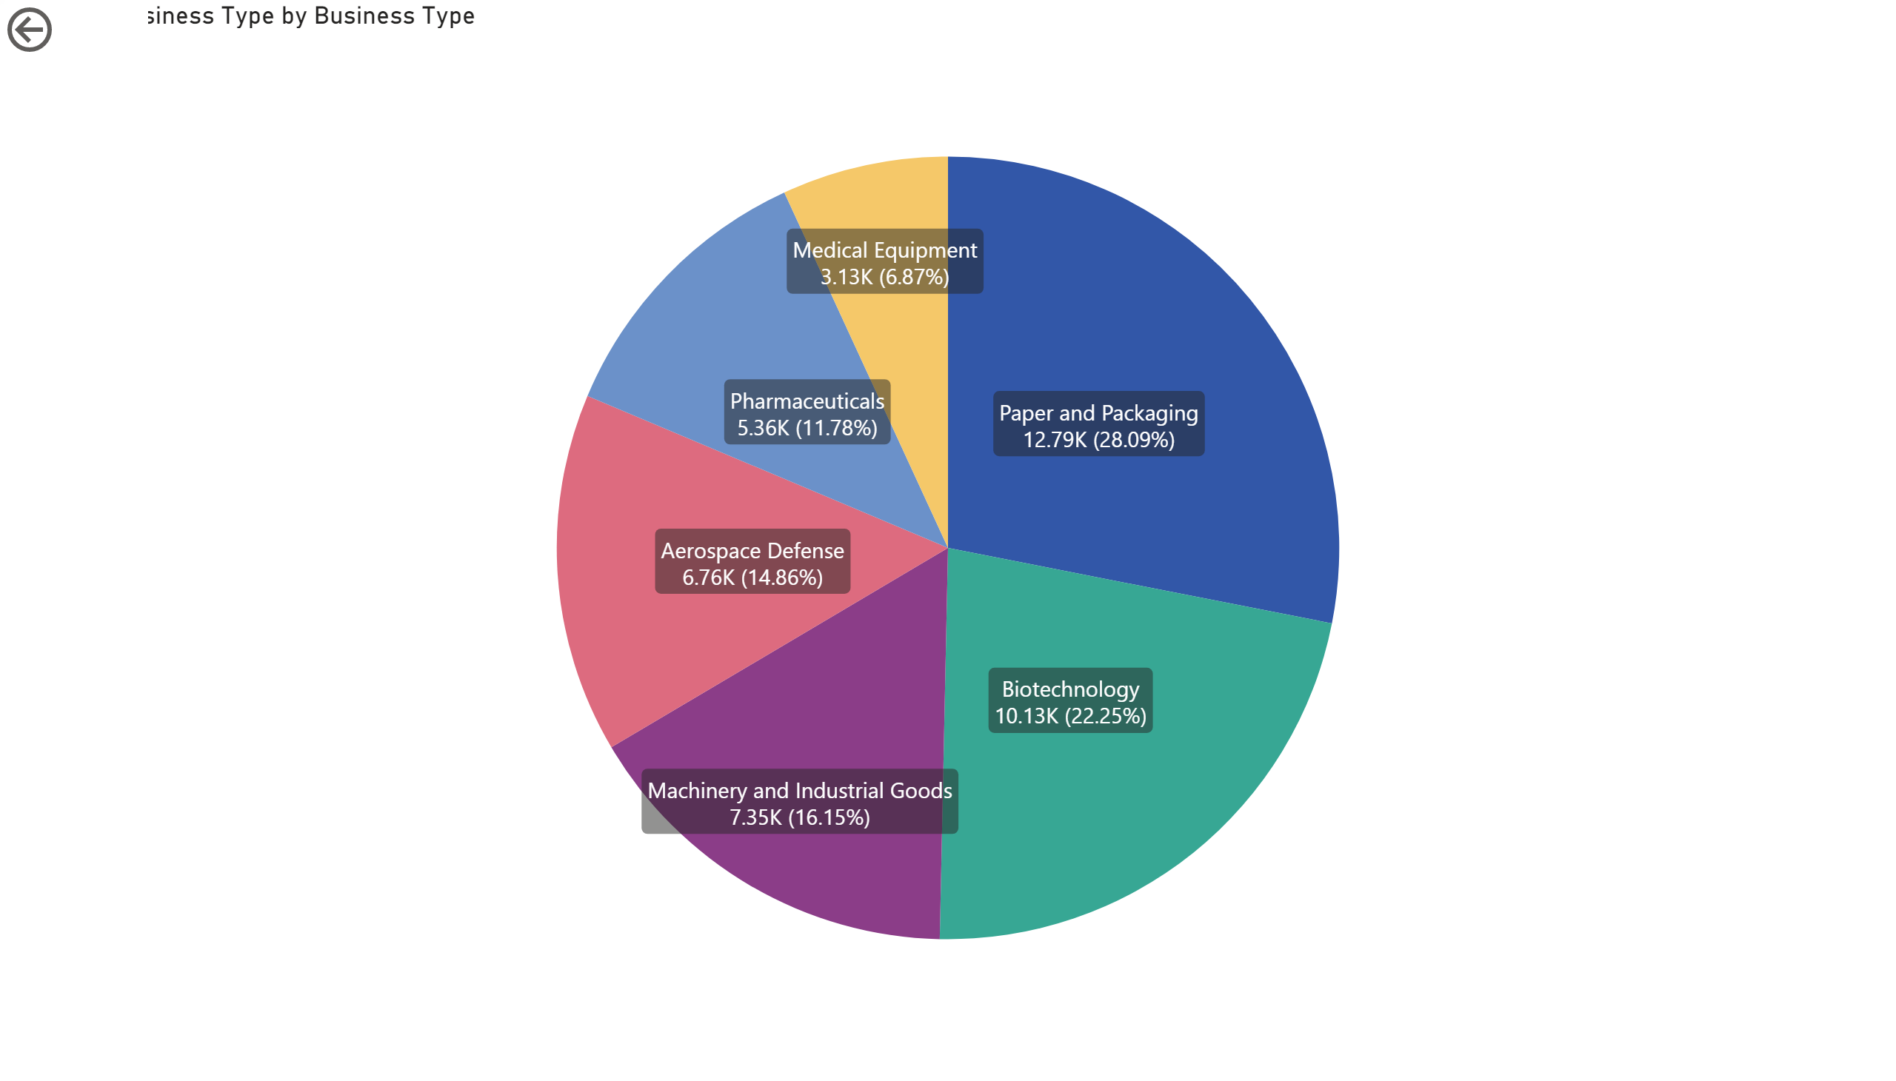
Paper and Packaging Industry is having largest customer base followed by Biotechnology and Machinery Goods.

Slide 3
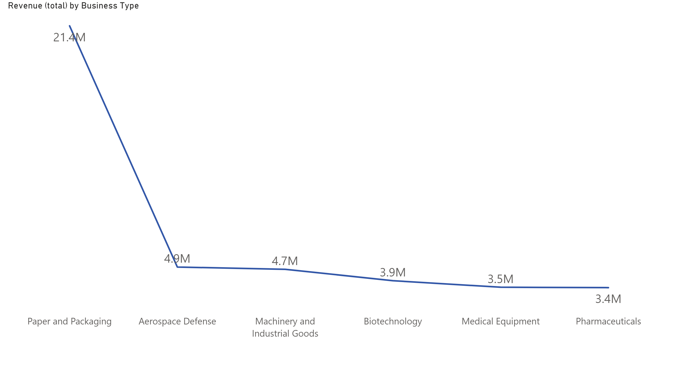

Slide 4
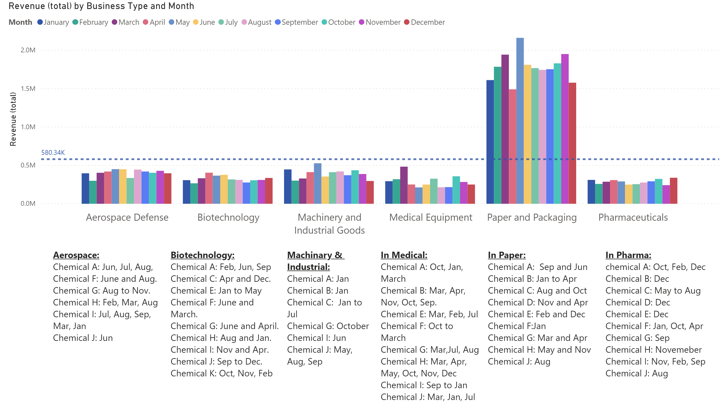

Slide 5
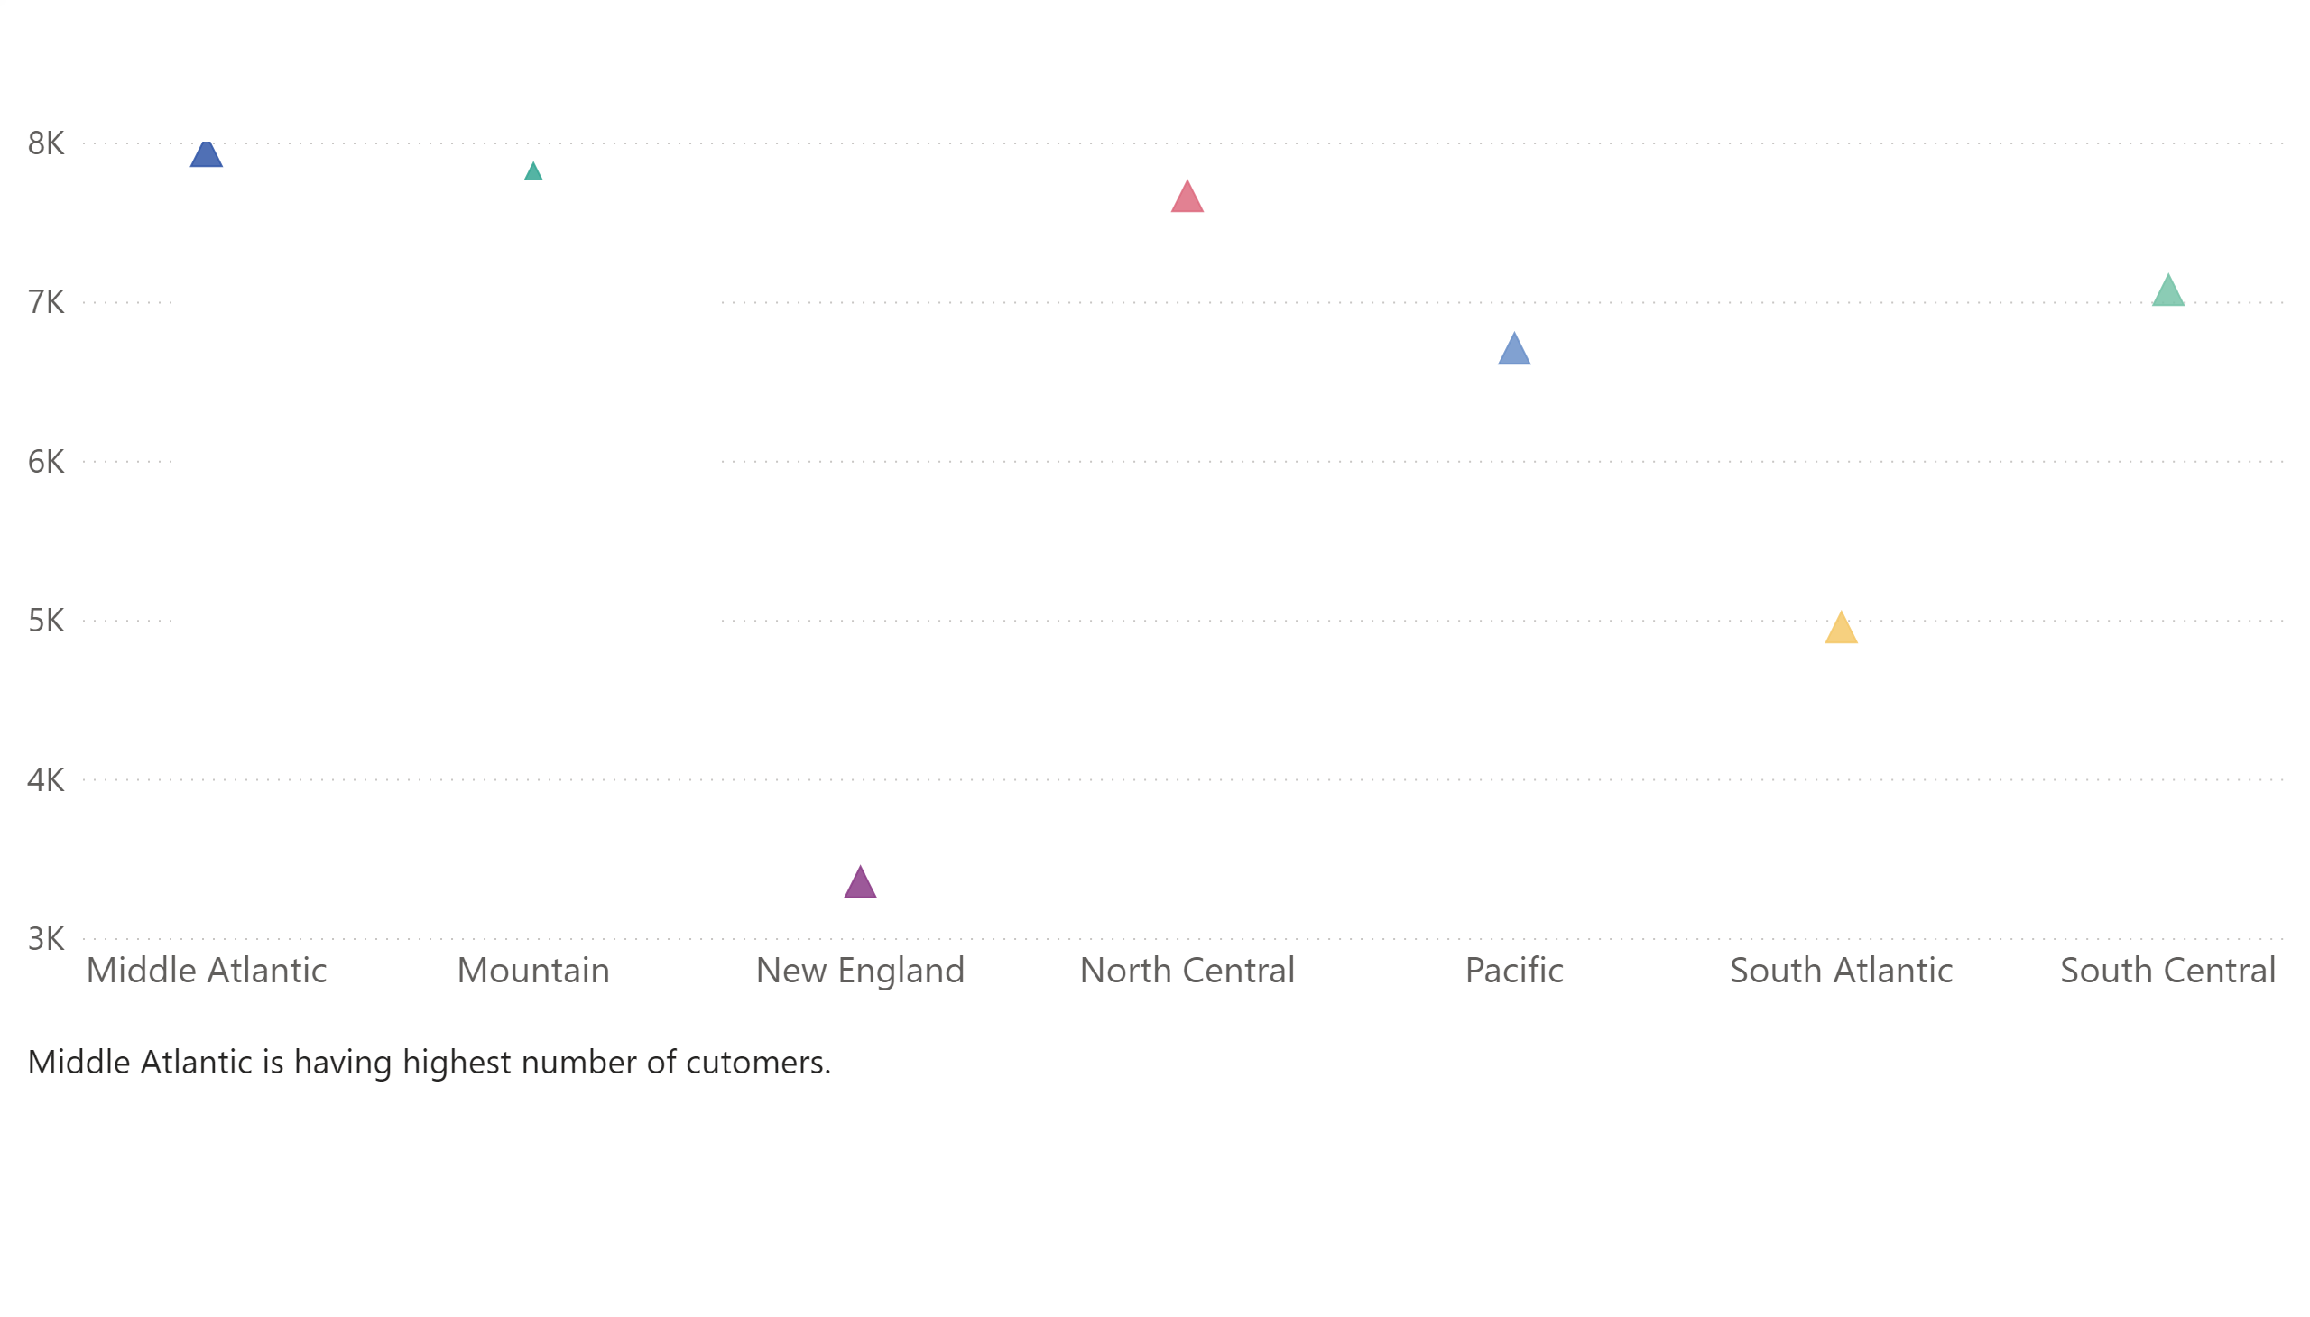

Slide 6
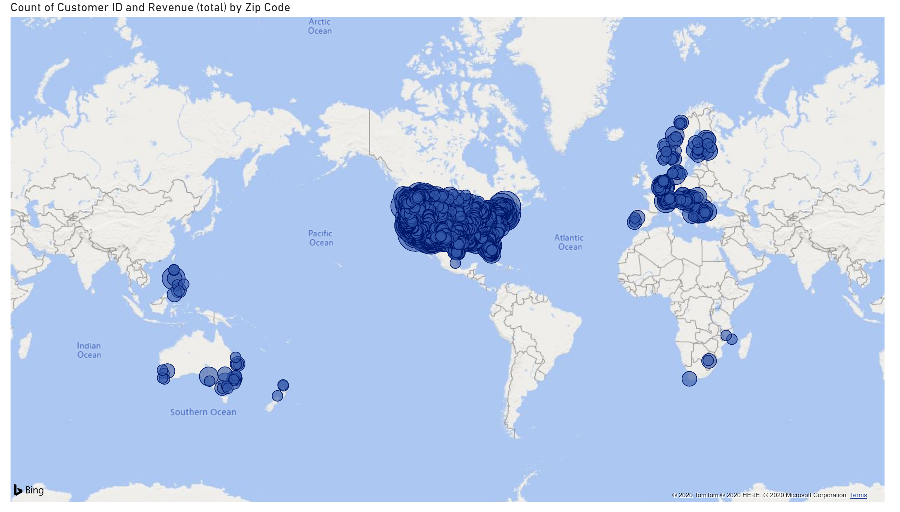

Slide 7
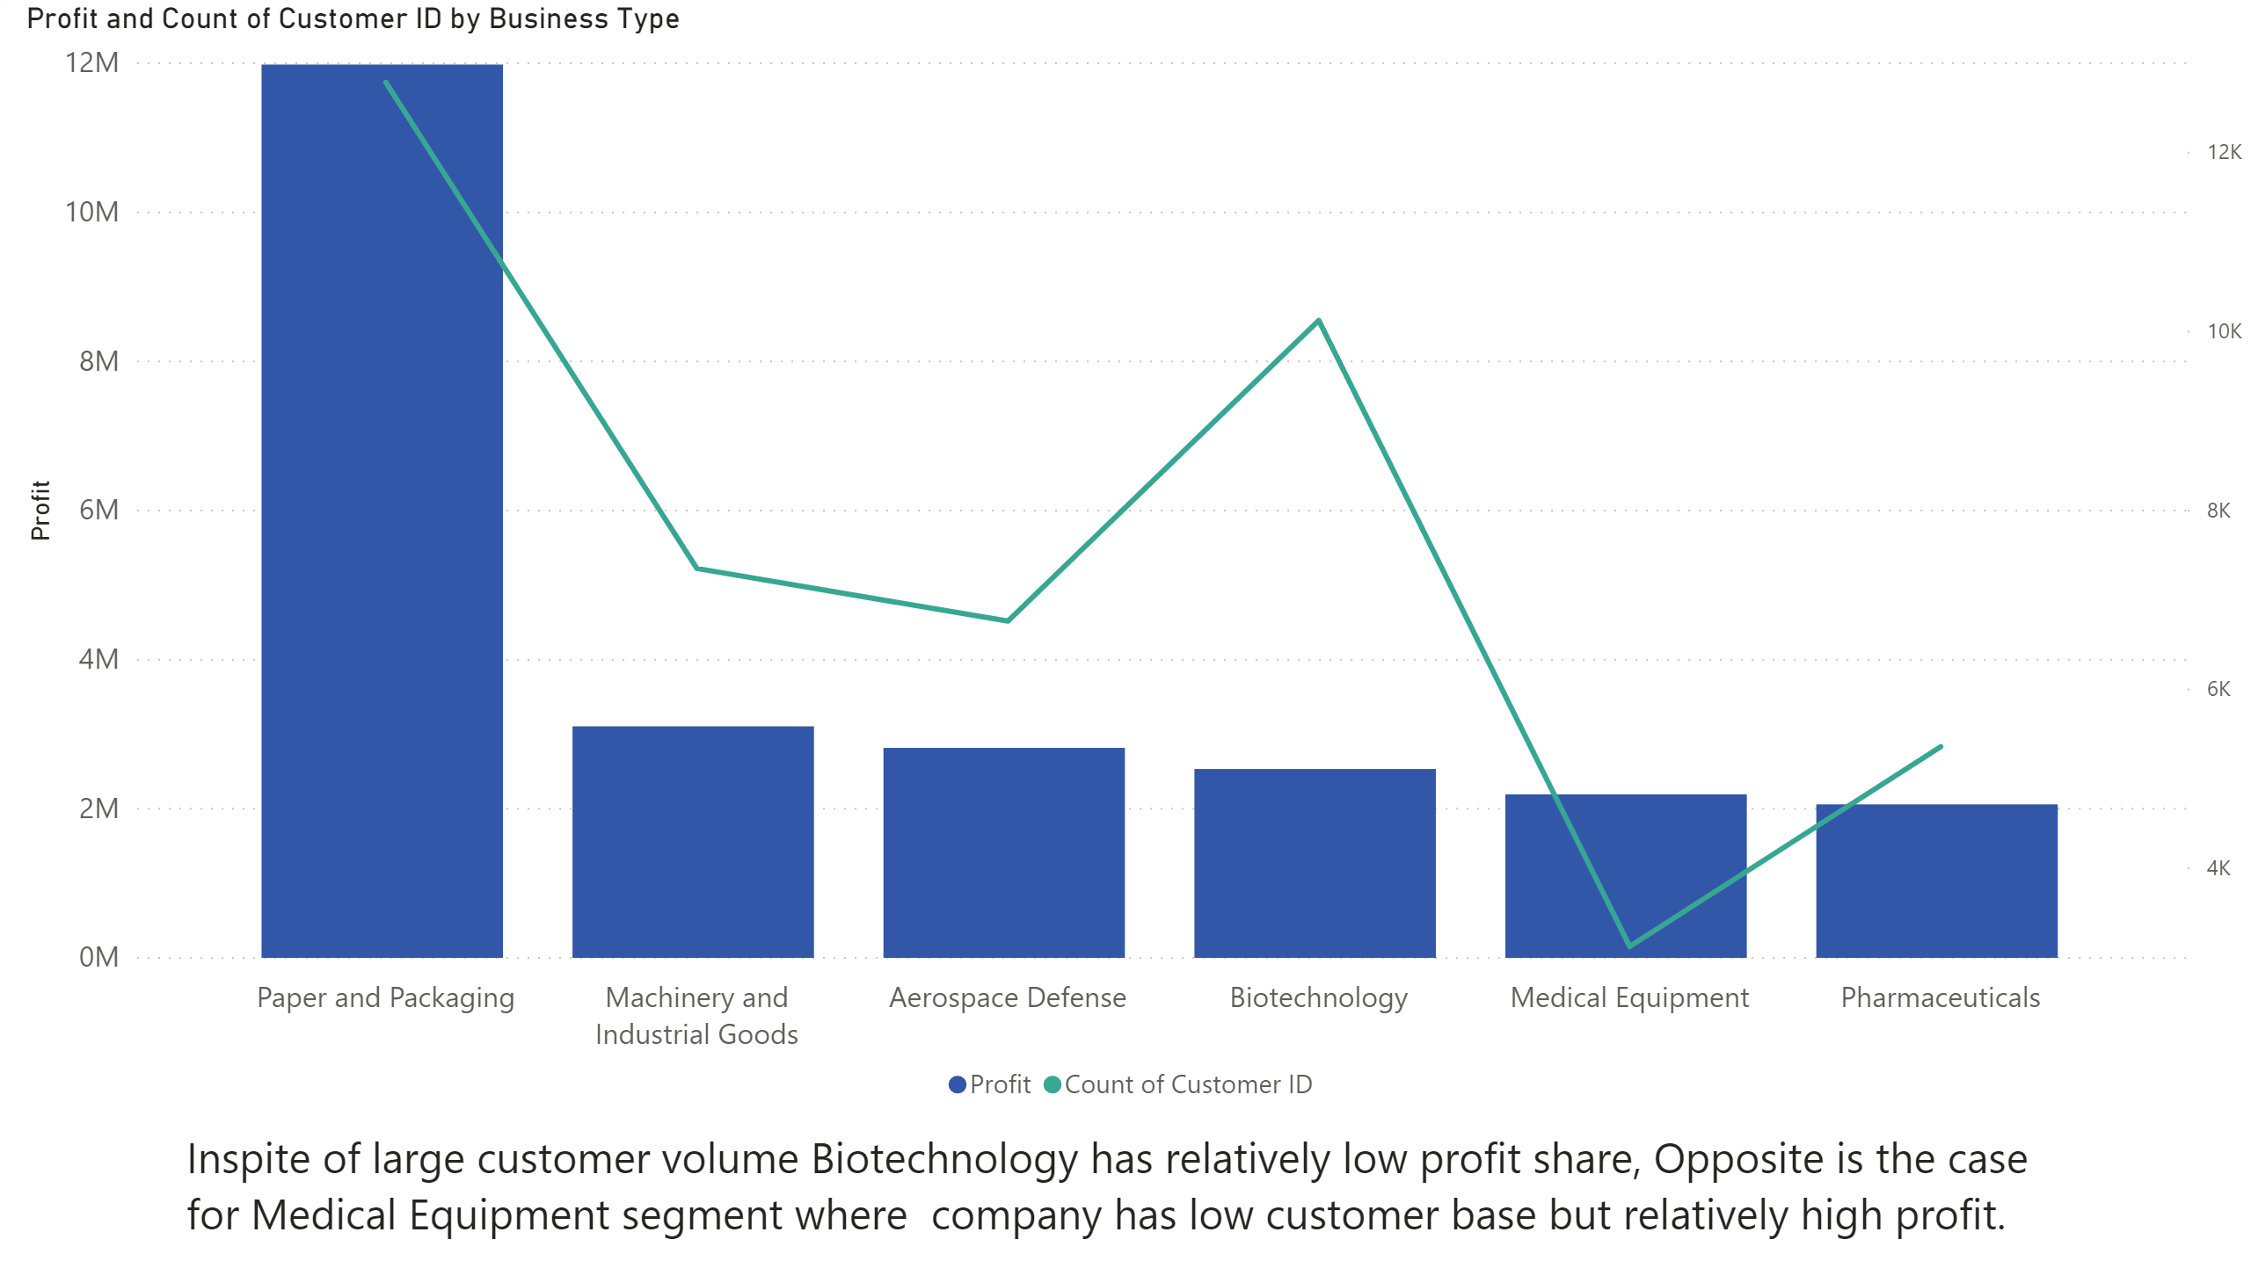

Slide 8
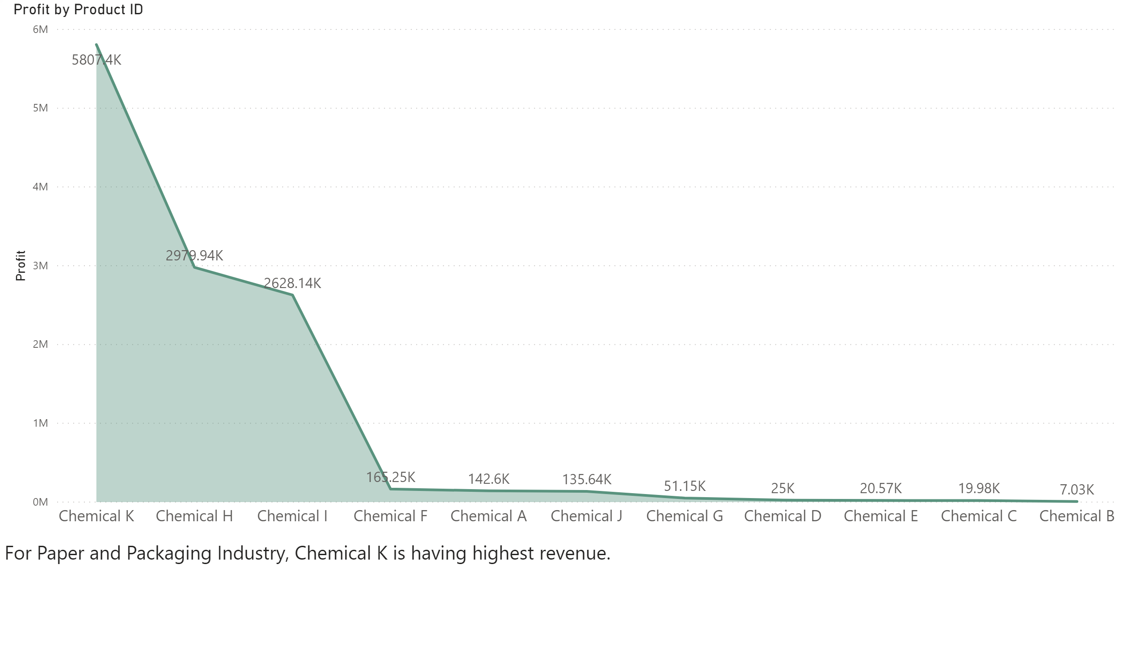

Slide 9
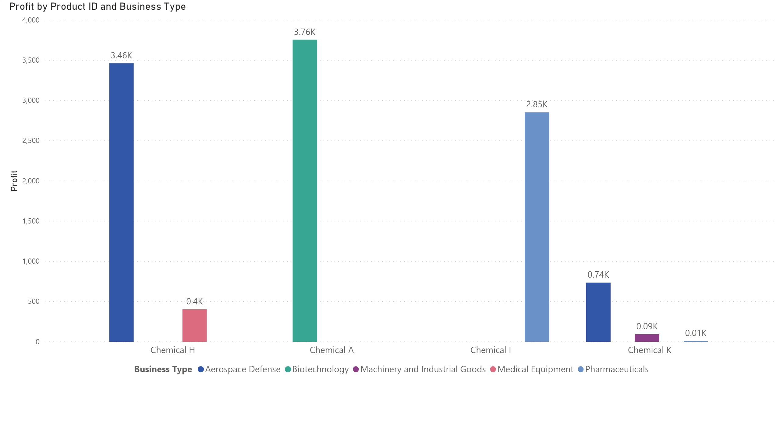
Low Margin Businesses

Slide 10
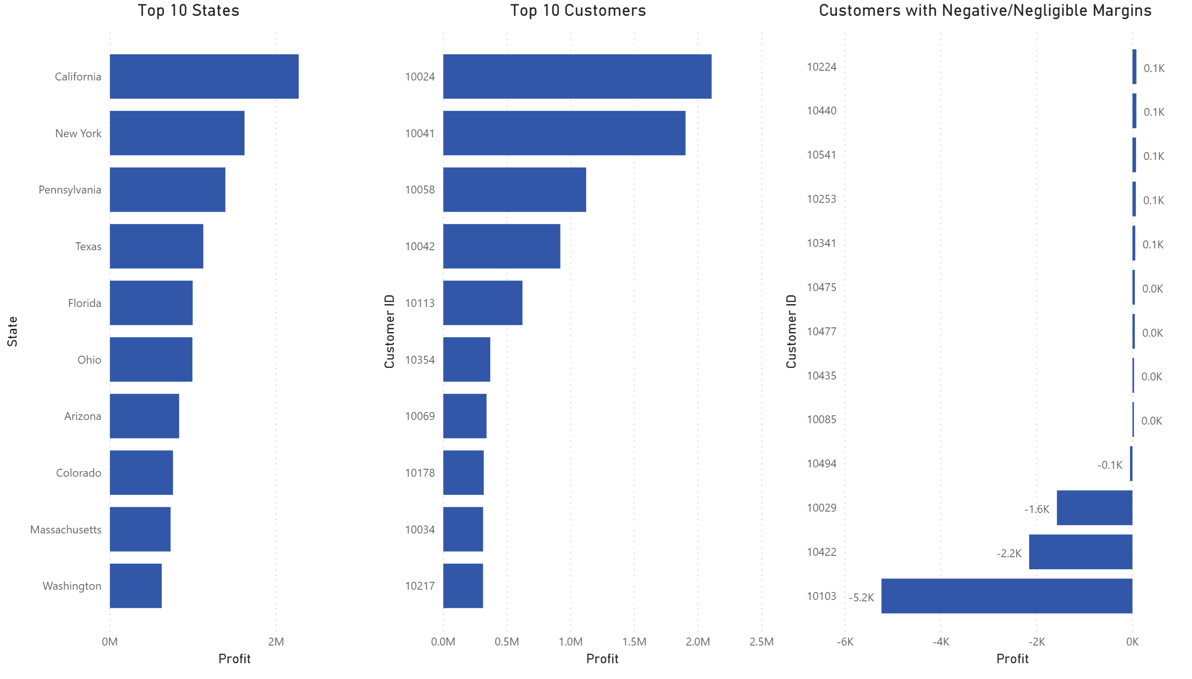
Business Insights

